Slide 1

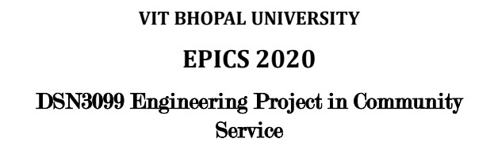

Slide 2

DeVoe’s Chair
Supervisor’s name: Dr. Susant Kumar Panigrahi
Team Members:
18BEC10007 - Anjali Prajapati
18BEC10037 - Khushi Rathore
18BEC10084 - Sushant Sharma
18BEC10088 - Utkarsh Gupta
18BCE10247 - Shikhar Srivastava
18BCE10074 - Ayushi Jaimani
18BCG10022 - Anutej Kardele

Slide 3
OBJECTIVE
This project is based on IOT(Internet of Things).
DeVoe’s Chair is a smart wheelchair which comes with a fall detection system, GPS tracking, sensing your body temperature, heart rate, SpO2 along with a home automation system which can be controlled by android application.
This chair is the future of care services around the globe, be it daycare for children or old age homes for elderly people.
The chair provides comfort and security to anyone who is in a need to carry out the basic day to day life activities.

Slide 4

Existing Projects
There’s been a project which is being made with a similar concept. In that project, a fall detection device was made which senses the jerk and alerts the loved ones of the user through Wifi.
Home automation systems are made with NODE-MCU(ESP8266) or raspberry pi.This project provides home automation only with wifi.
In our project we are adding multiple modules.Firstly we are using ESP32 ; it has wifi as well as bluetooth modules. We are trying to use low cost components and adding different modules to the chair.

Slide 5
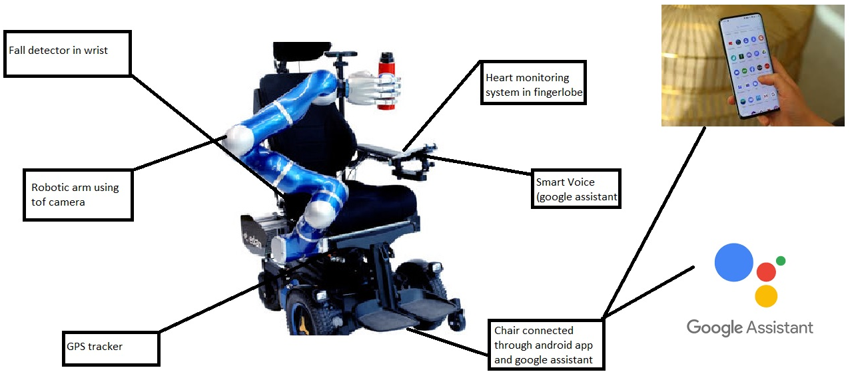
Design of the chair
(This part to be added in future)

Slide 6
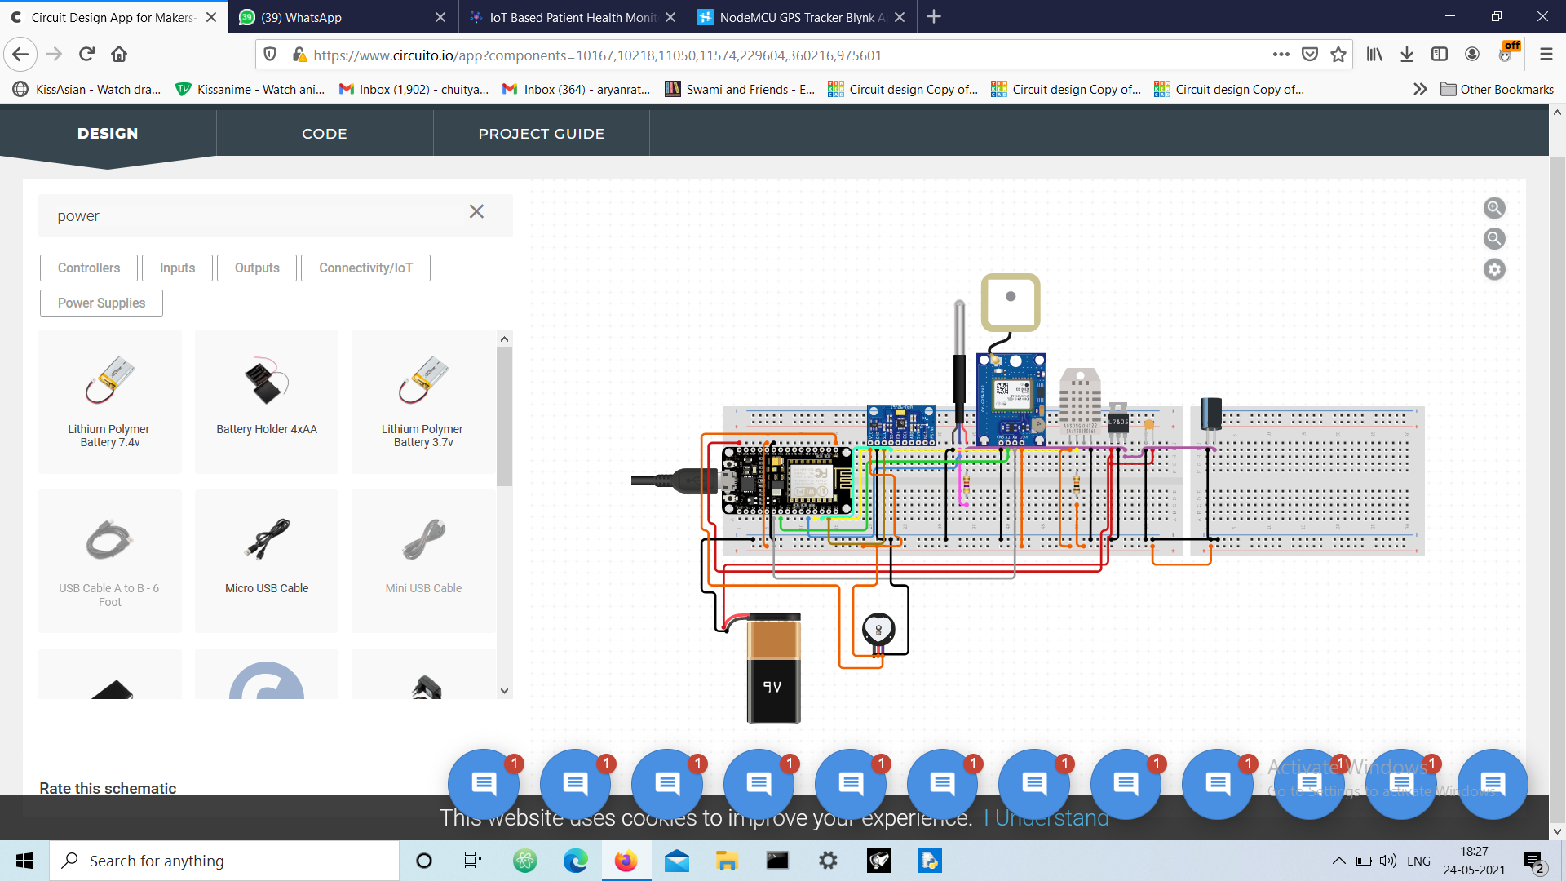
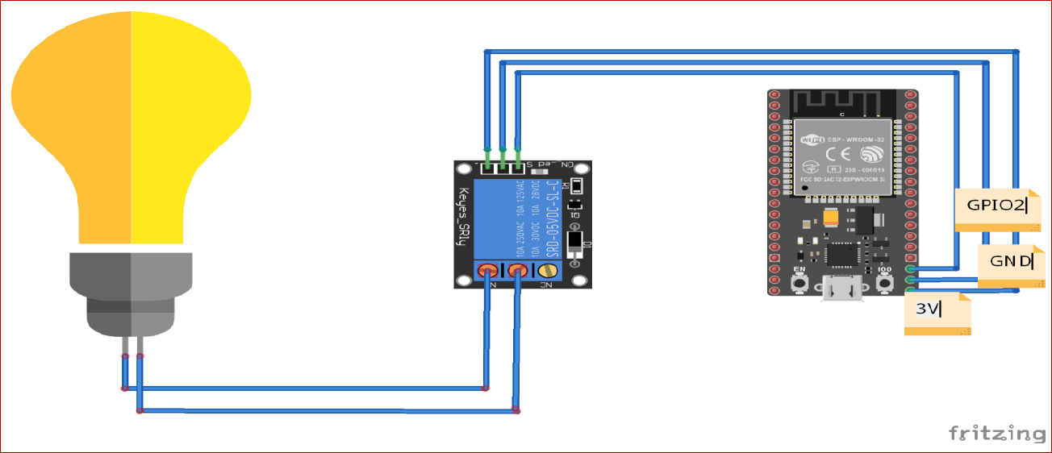
Circuit Diagram
Circuit diagram of home automation using esp32
Circuit diagram of health monitoring, gps tracker and fall detection system using nodemcu

Slide 7
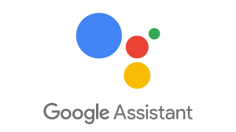
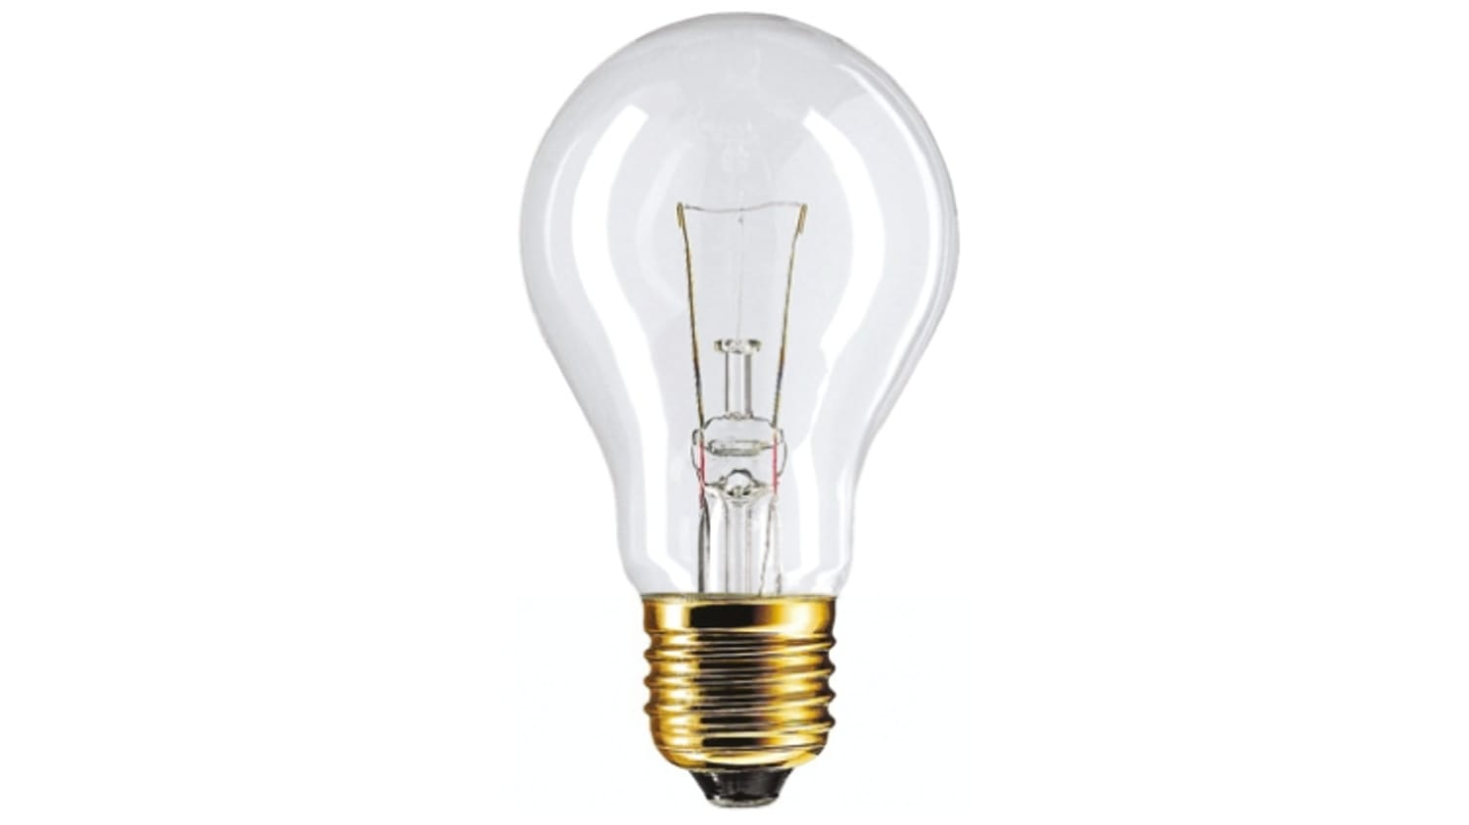
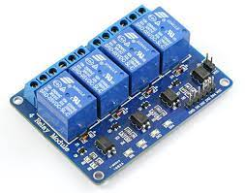
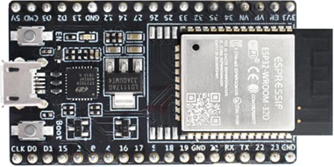
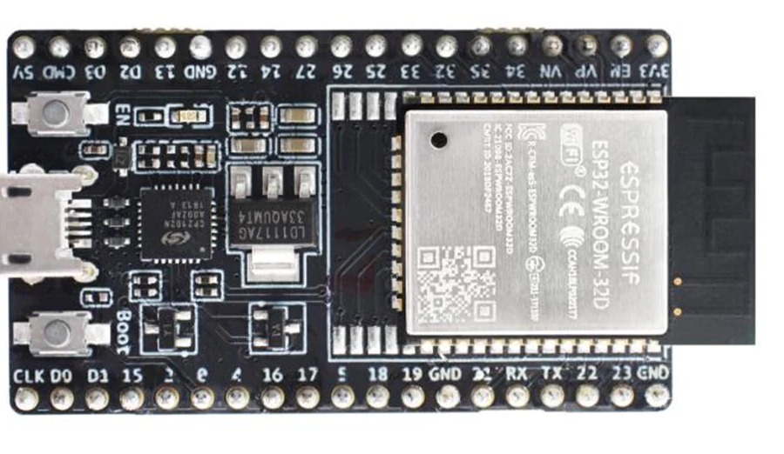
Module 1: Home Automation System
Purpose:
Smart Home Systems is a concept in which all the electrical appliances or the devices are controlled using a single remote control(mobile application) and smart voice.
We are going to connect some of the home’s electrical appliances to the Relay module and control it through ESP32 Microcontroller.
Components Required:
ESP32
Relay
Breadboard
Connecting Wires

Slide 8
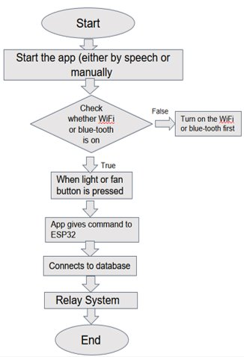
Association:
Flowchart:
In the above block diagram, the flow of this project is shown. The relays are connected to the home’s electrical appliances or devices. A mobile application will send an On or OFF command to the database. This cloud is connected to the ESP32 microcontroller board through WiFi. To Switch the electronic device on, we will send a “1” in the database and to switch it off we will send a “0” in the database. This command will then be fetched by the microcontroller because it is also connected to the database. Based on this 0 or 1, the microcontroller will switch the relay module on or off which will ultimately result in the switching of the electrical appliances.

Slide 9
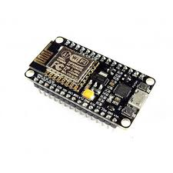
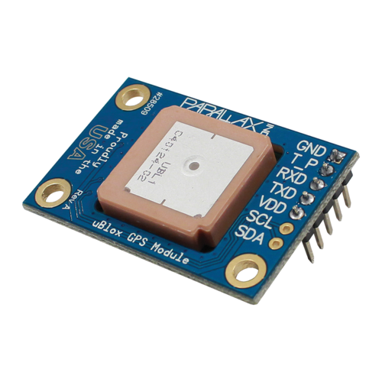
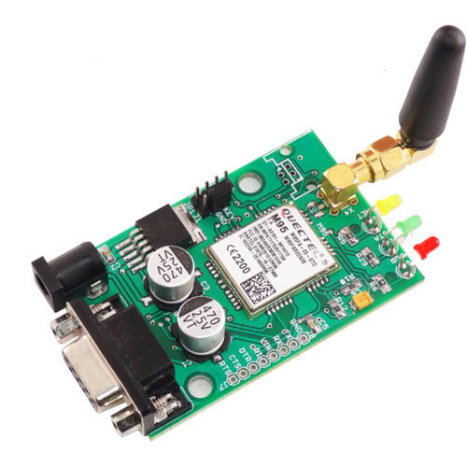
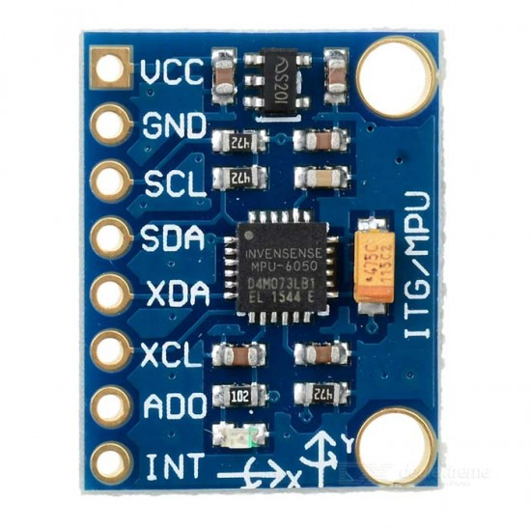
Module 2: Fall Detection System
Purpose:
The main purpose of this module is to detect if the person has fallen so that he/she can be helped on time.
The system uses accelerometer and gyro sensor to detect person movements, It can be mounted on persons hand or wheelchair for detection.
Components Required:
Breadboard, Resistors, Capacitors
Triple axis accelerometer+ Gyroscope(MPU6050)
NodeMCU
Buzzer
Software Used:
Arduino
IFTTT Server

Slide 10
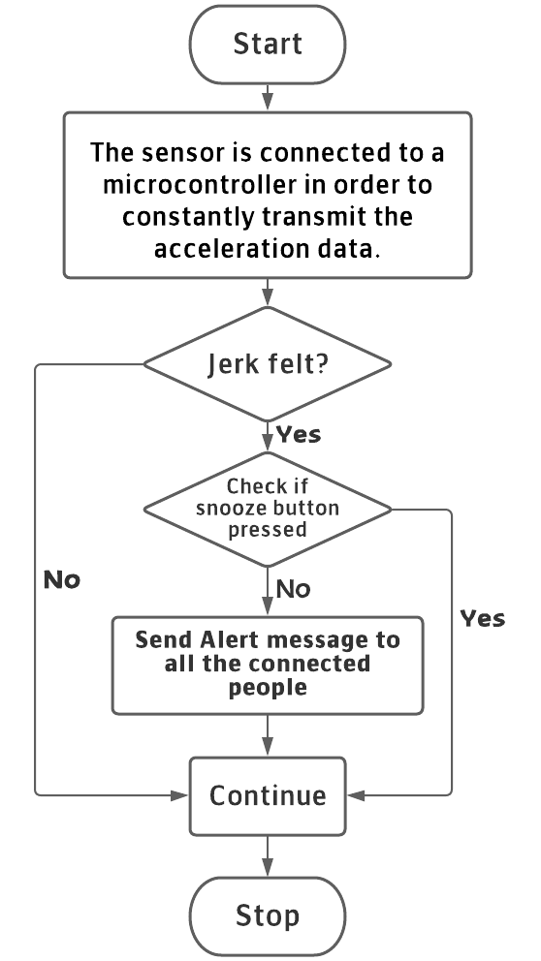
Association:
Flowchart:
●The sensor is connected to a microcontroller in order to constantly transmit the acceleration data.
●The system keeps monitoring for fall detection and abrupt movement changes in person.
●A sudden abrupt change with jerk in the system is treated as a fall.
●If in case the person did not fall and alarm was false, the system allows to snooze the alert if person presses snooze button in 5 seconds.
●If person does not press the snooze, system detects person has fallen and automatically triggers alert through wifi connection to alert the loved ones of the person about the situation instantly.

Slide 11
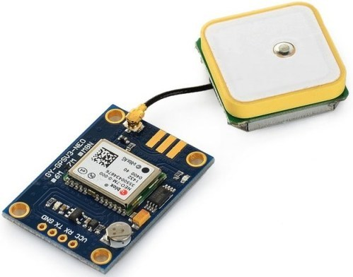
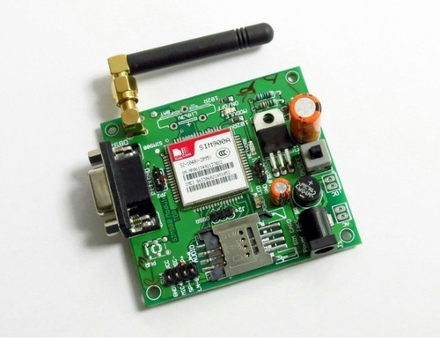
Module 3: GPS Tracking System
Purpose:
We have connected a GPS tracking system to the Wheelchair in order to get the exact location of chair, if the user’s caretaker/concerned people want to and in case of fall too. GSM technology is used to send text message, voice call and also the location to the patient’s guide.
Components Required:
ESP8266
NEO-6M GPS Module
GSM SIM900

Slide 12
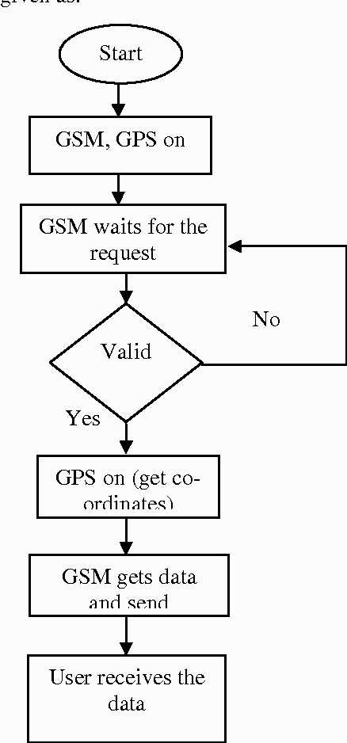
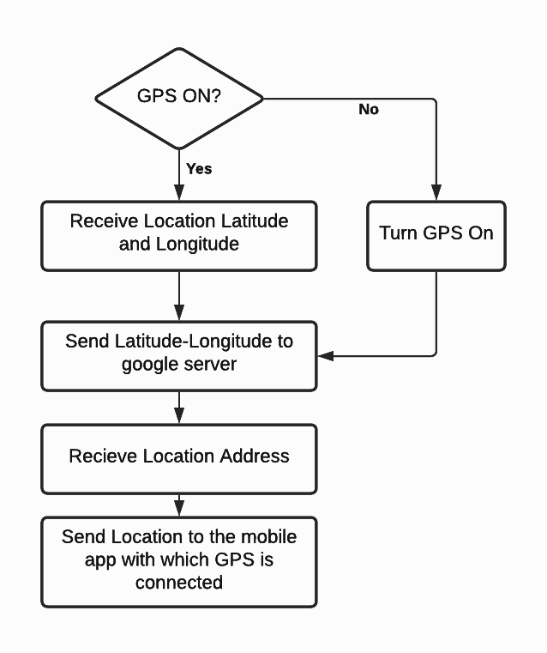
Flowchart:
For GSM
For GPS

Slide 13
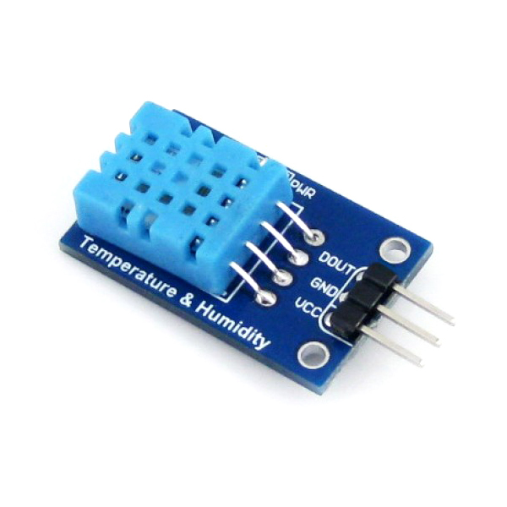
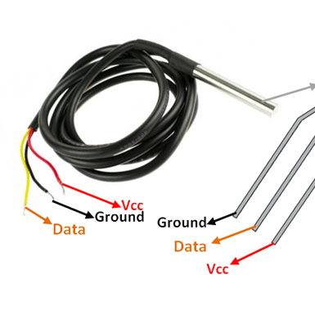
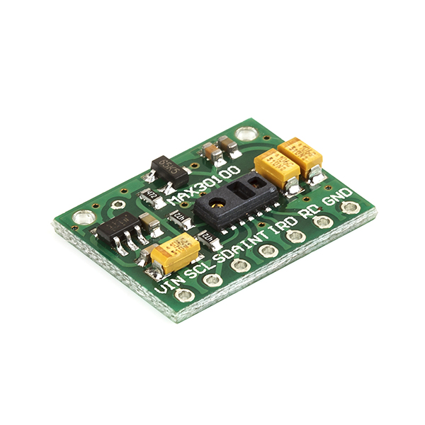
Module 4: Measuring the body temperature and heart rate
Purpose:
Our device puts forward a smart patient health tracking system using Web Server so that the Patient health parameters like Heart Rate and Blood Oxygen level along with body temperature as well as room temperature can be monitored.
User interface will be the android app and google assistant.
Components Required:
ESP32
MAX30100/102 Pulse Oximeter Sensor
DS18B20 Temperature Sensor
DHT11 Humidity Sensor

Slide 14
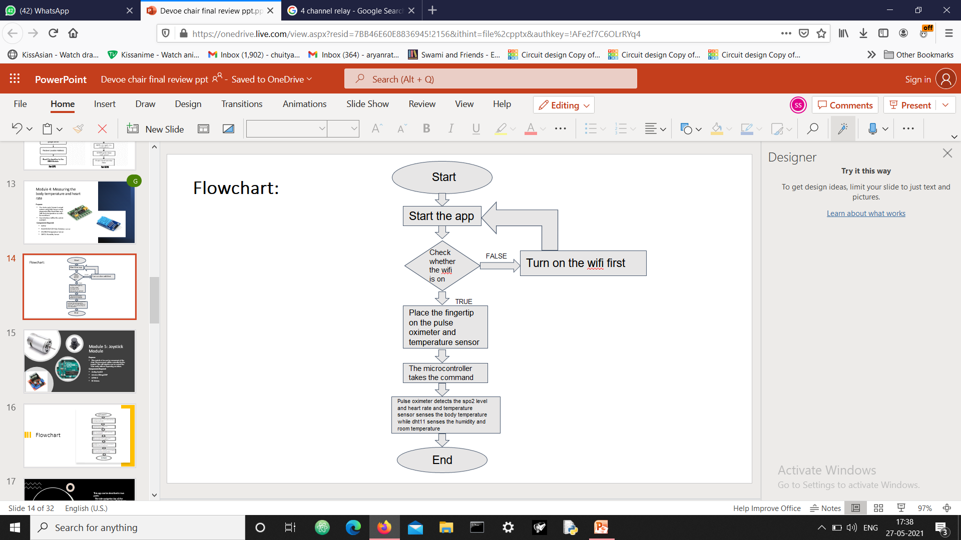
Association:
Flowchart:
We will use the MAX30100/102 Pulse Oximeter sensor to measure the Heart Rate/Pulse(BPM) as well as the Blood Oxygen Level(SpO2). We will use a DS18B20 Temperature Sensor to measure the temperature of the body. Similarly Patient needs to be placed in a room with a certain temperature and humidity level so that he doesn’t feel uncomfortable. In order to do that we need to monitor the room temperature and humidity as well. So we will be using DHT11 Humidity & Temperature Sensor. This all be monitored through app. If anything goes above the critical values it will send a message to the family members.

Slide 15
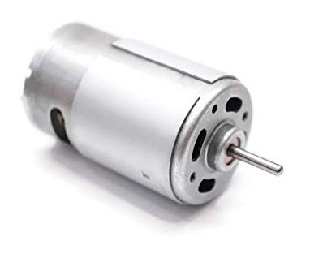
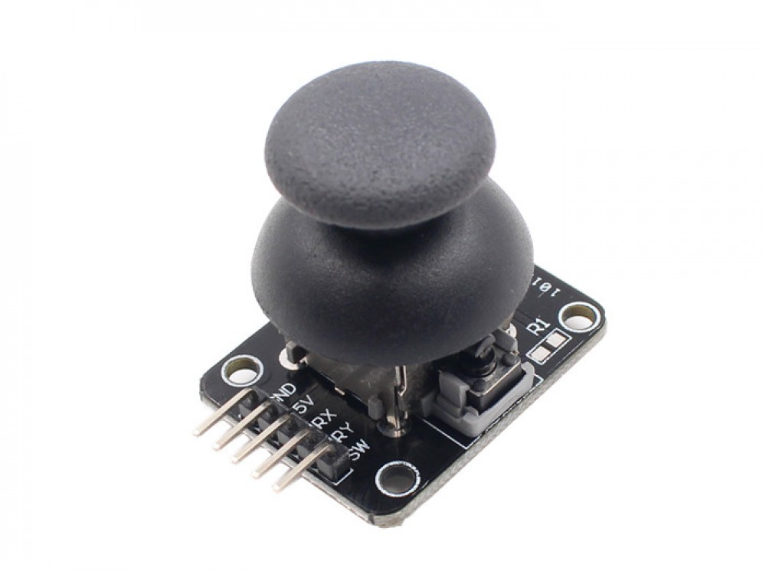
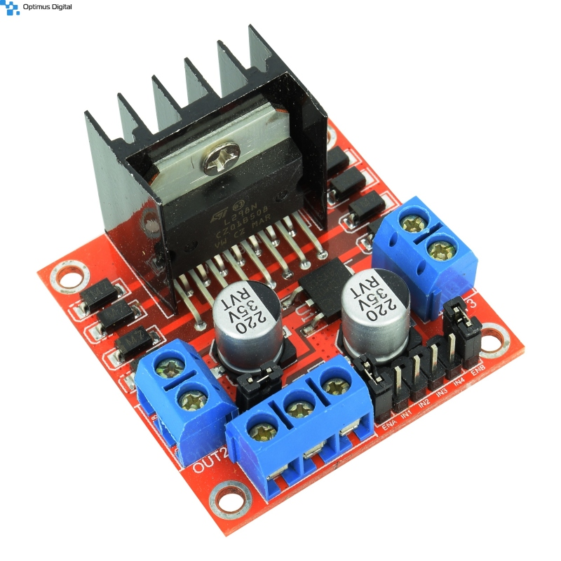
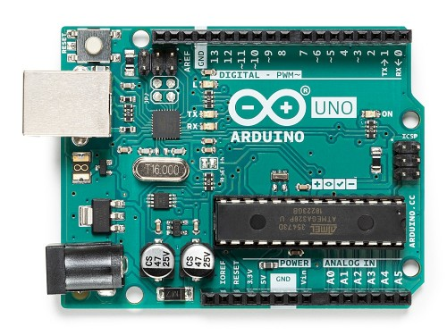
Module 5: Joystick Module
Purpose:
This module is focused on movement of the chair. The movement will be controlled by the joystick. This will help the user to control the chair easily without depending on others.
Components Required:
Analog Joystick
Arduino ATMega328P
L298N IC
DC Motors

Slide 16
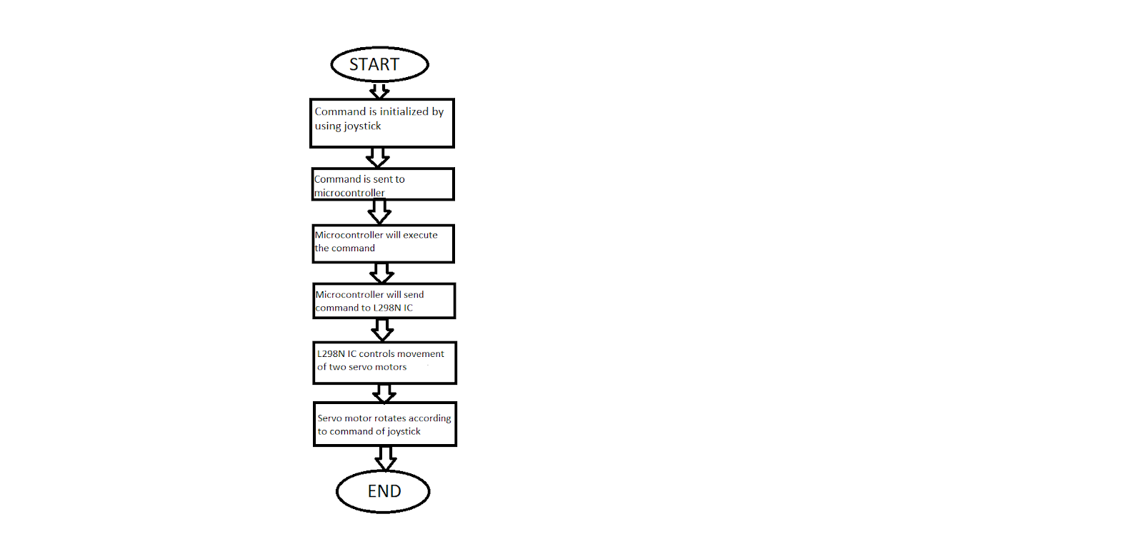
Flowchart:

Slide 17
This app can be described in two parts:
The side navigation bar of the app provides a user with features like: home-automation, body temperature monitoring, pulse, location, authentication and settings
The bottom navigation bar of the app provides information regarding the current updates of COVID-19, like: statistics, current news, hospitals, requirements etc. as it is the need of the hour.
Module 6: Devoe's App

Slide 18
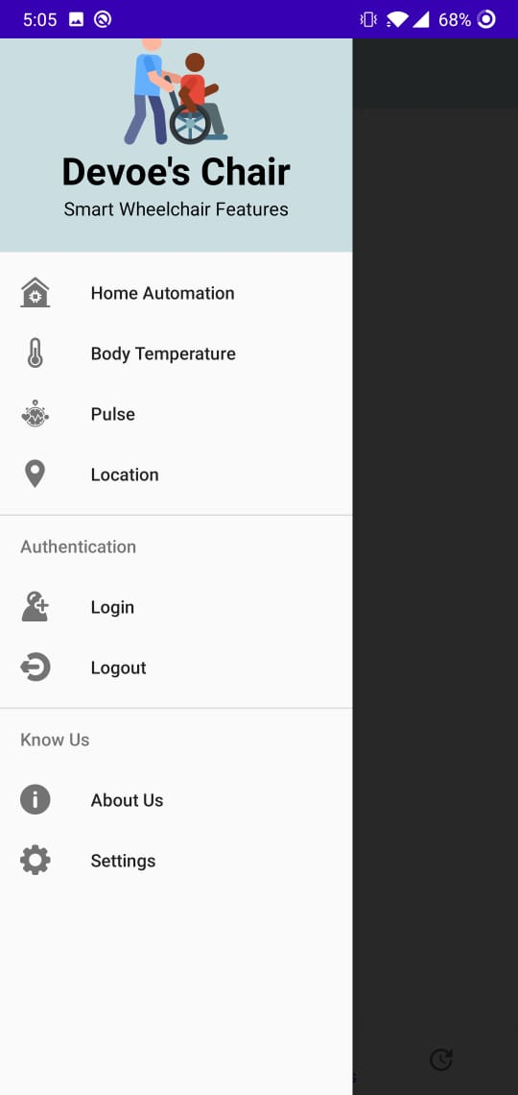
Side Navigation Bar:
Home Automation will allow us to connect the home appliances which could be later controlled by the use of our app providing an ease to the person in wheelchair.
Body Temperature is crucially important when it comes to patients who are incapable of taking care of themselves. We have installed an in-built thermometer which will help them monitor their body temperature without much external help.
Pulse is equally viable for any patient’s progress and thus an in-built heart rate monitor (HRM), a personal monitoring device that allows one to measure/display heart rate in real time or record the heart rate for later study. It is largely used to gather heart rate data while performing various types of physical exercise.
Location of the wheelchair can also be monitored by the use of an in-built GPS tracker enabled in our app.
Authentication includes login and logout of the application as per suitability.
Settings will consist of font variations and sizes, along with themes, etc.

Slide 19
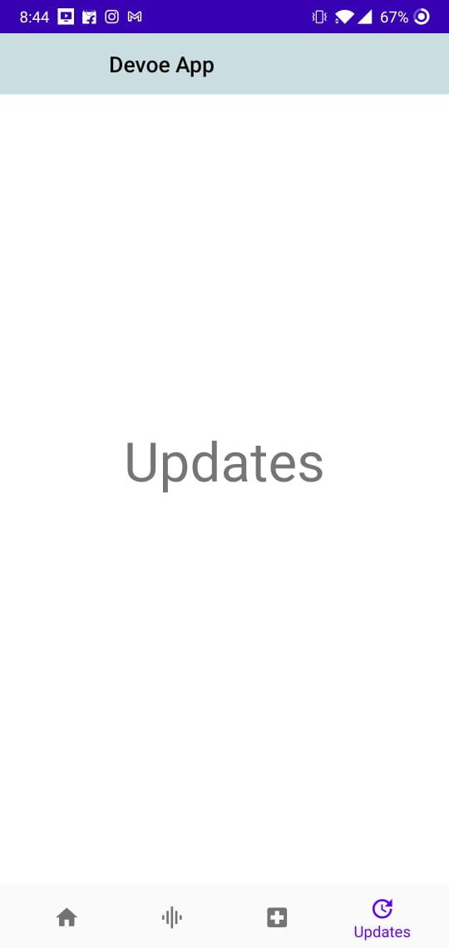
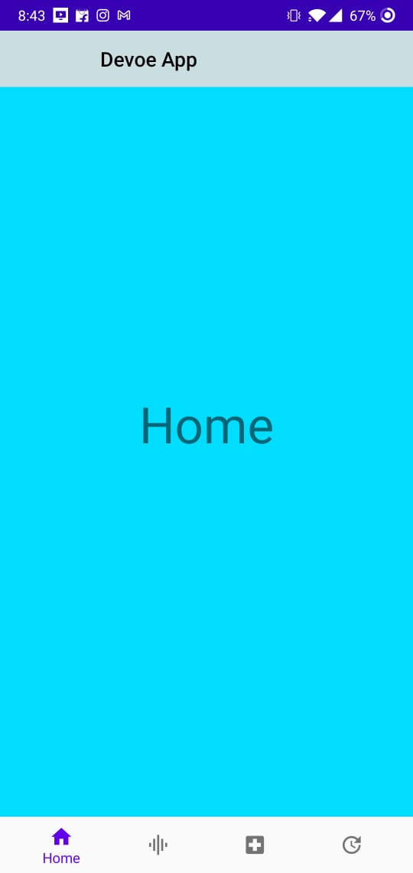
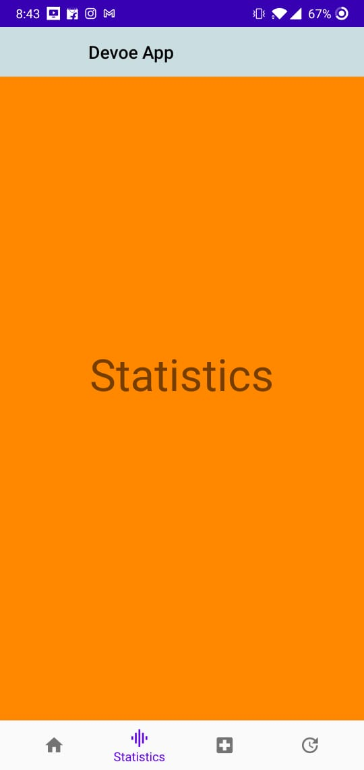
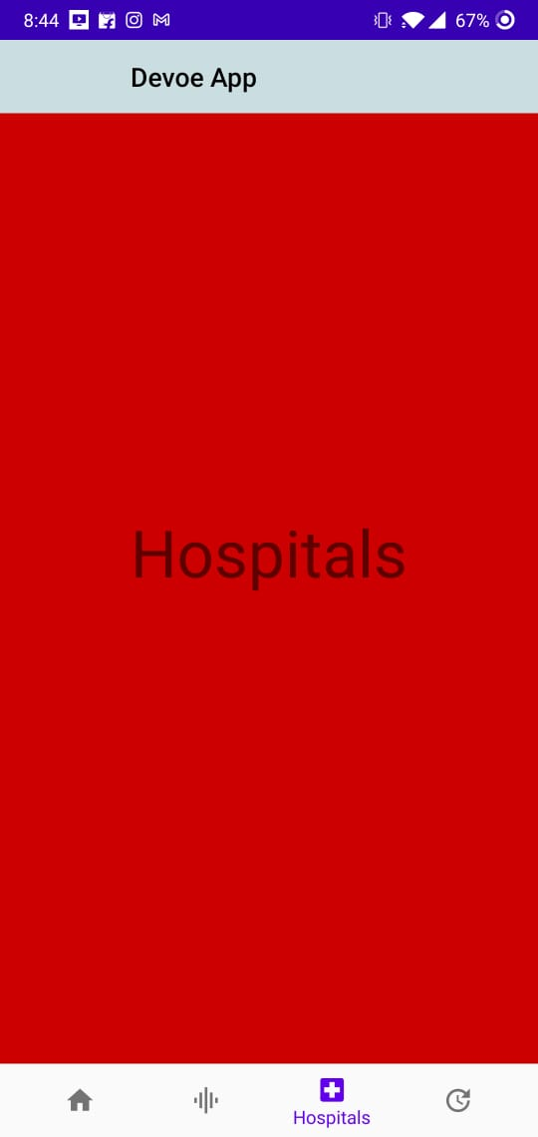
Bottom Navigation Bar:
HOME- This will provide information regarding the on-going COVID situation such as news updates.
STATISTICS- The rising number of cases, death toll, recovery rate, etc. will all be provided here in this section.
HOSPITALS- Information consisting of the locations of hospitals will be categorized here state wise and area wise so that a person can locate the nearest hospital facility.
UPDATES- Requirement details like vaccine dose, oxygen and bed availability for patients in different parts of the country will be found in this part of the application so as to help the people stay updated.

Slide 20
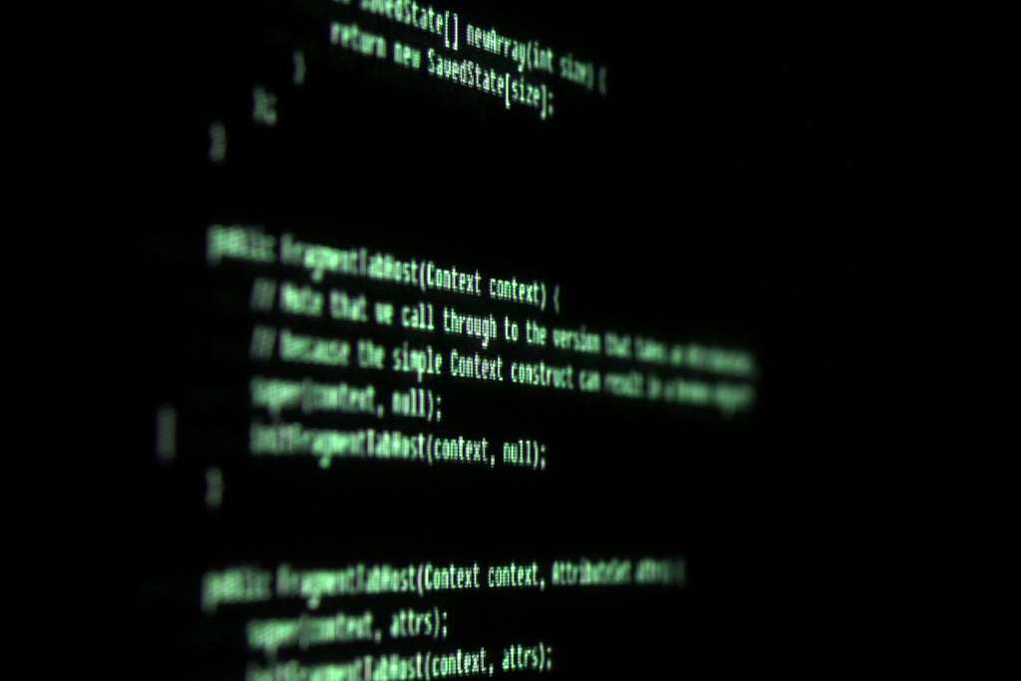
API
API stands for Application Programming Interface. An API is a software intermediary that allows two applications to talk to each other. In other words, an API is the messenger that delivers your request to the provider that you’re requesting it from and then delivers the response back to you.
When developers create code, they don’t often start from scratch. APIs enable developers can make repetitive yet complex processes highly reusable with a little bit of code. The speed that APIs enable developers to build out apps is crucial to the current pace of application development.

Slide 21
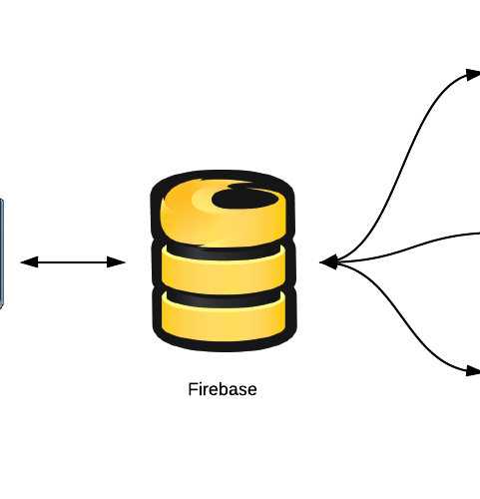
Firebase Database
The Firebase Realtime Database is a cloud-hosted database. Data is stored as JSON and synchronized in real-time to every connected client. When you build cross-platform apps with our iOS, Android, and JavaScript SDKs, all of your clients share one Realtime Database instance and automatically receive updates with the newest data.
The Realtime Database provides a flexible, expression-based rules language, called Firebase Realtime Database Security Rules, to define how your data should be structured and when data can be read from or written to. When integrated with Firebase Authentication, developers can define who has access to what data, and how they can access it.

Slide 22
Implementation Path
Integrate the Firebase Realtime Database SDKs
Create Realtime Database References
Set Data and Listen for Changes
Enable Offline Persistence
Secure your data

Slide 23
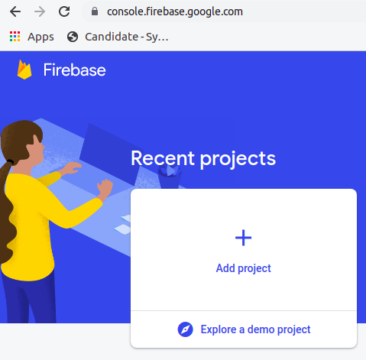
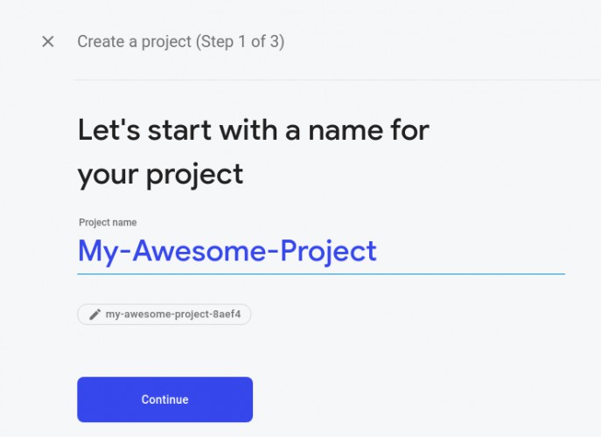
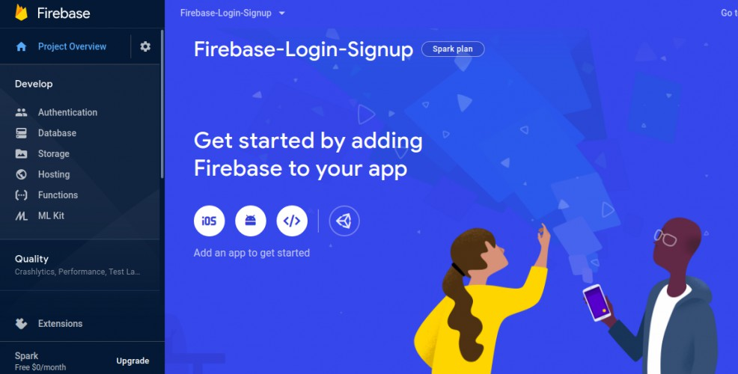
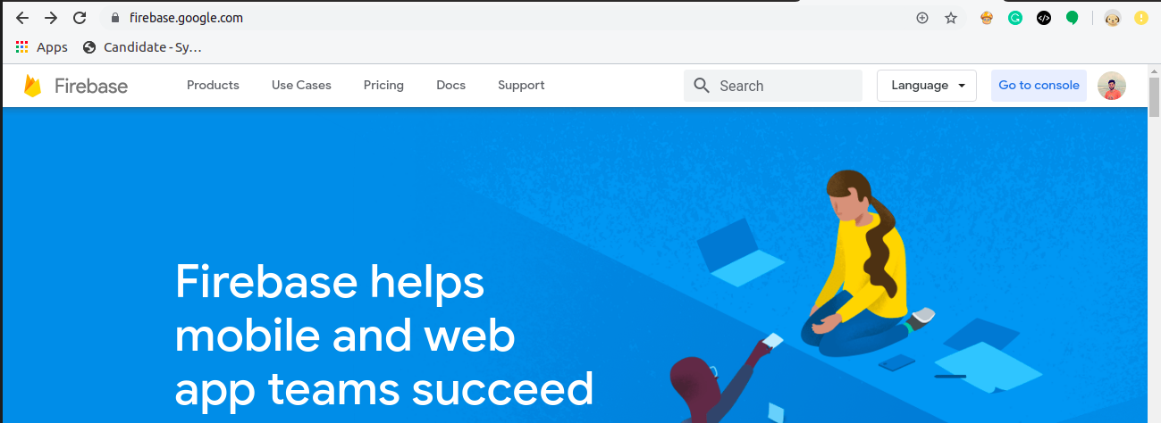

Slide 24
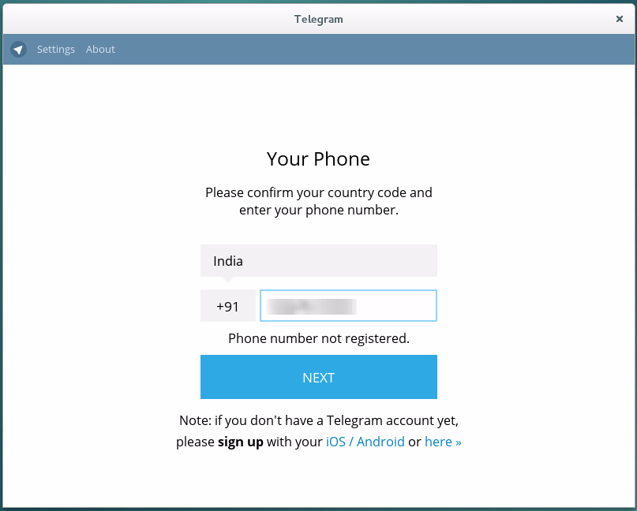
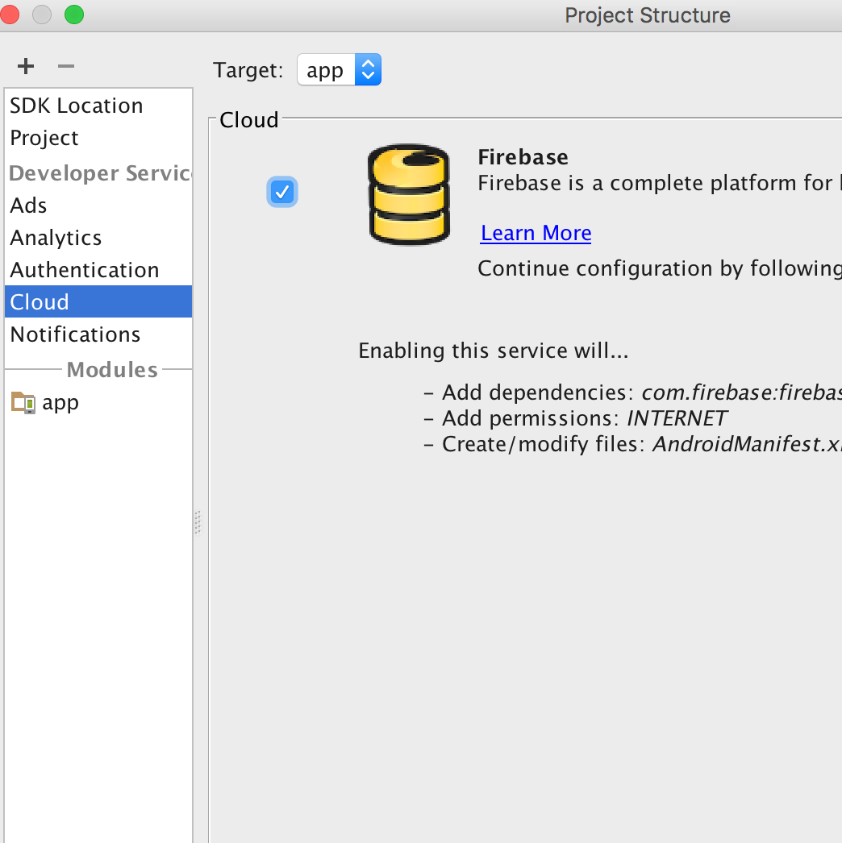
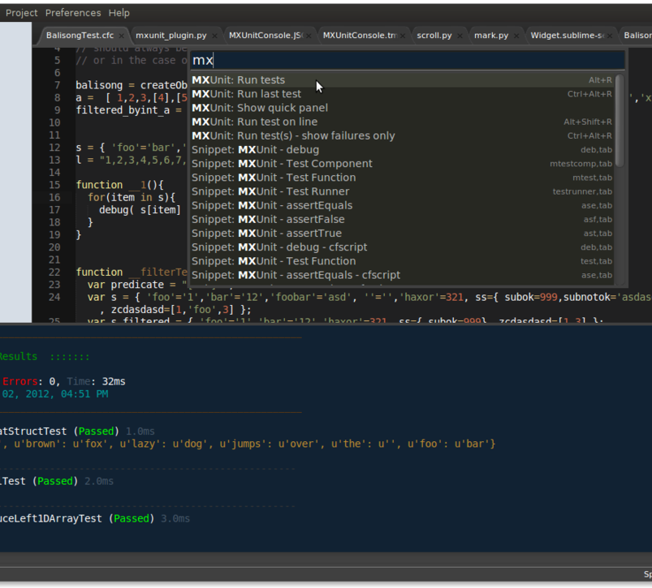
OTP Verification
You can use Firebase Authentication to sign in a user by sending an SMS message to the user's phone. The user signs in using a one-time code contained in the SMS message.
The easiest way to add phone number sign-in to your app is to use Firebase UI, which includes a drop-in sign-in widget that implements sign-in flows for phone number sign-in, as well as password-based and federated sign-in. This document describes how to implement a phone number sign-in flow using the Firebase SDK.

Slide 25
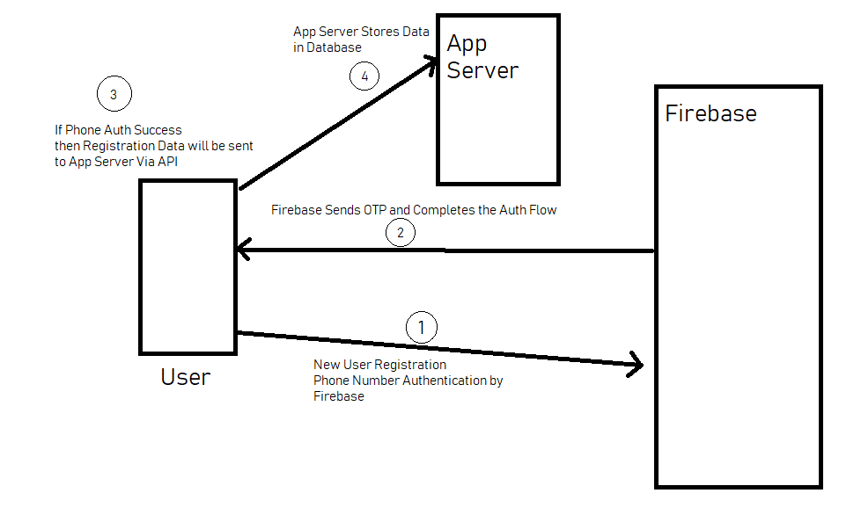
Among all of them, I am going to demonstrate about Firebase Authentication. Firebase authenticates the user by sending One Time Password (OTP) via SMS to their phones. This image is useful to understand the process of Firebase Authentication.

Slide 26
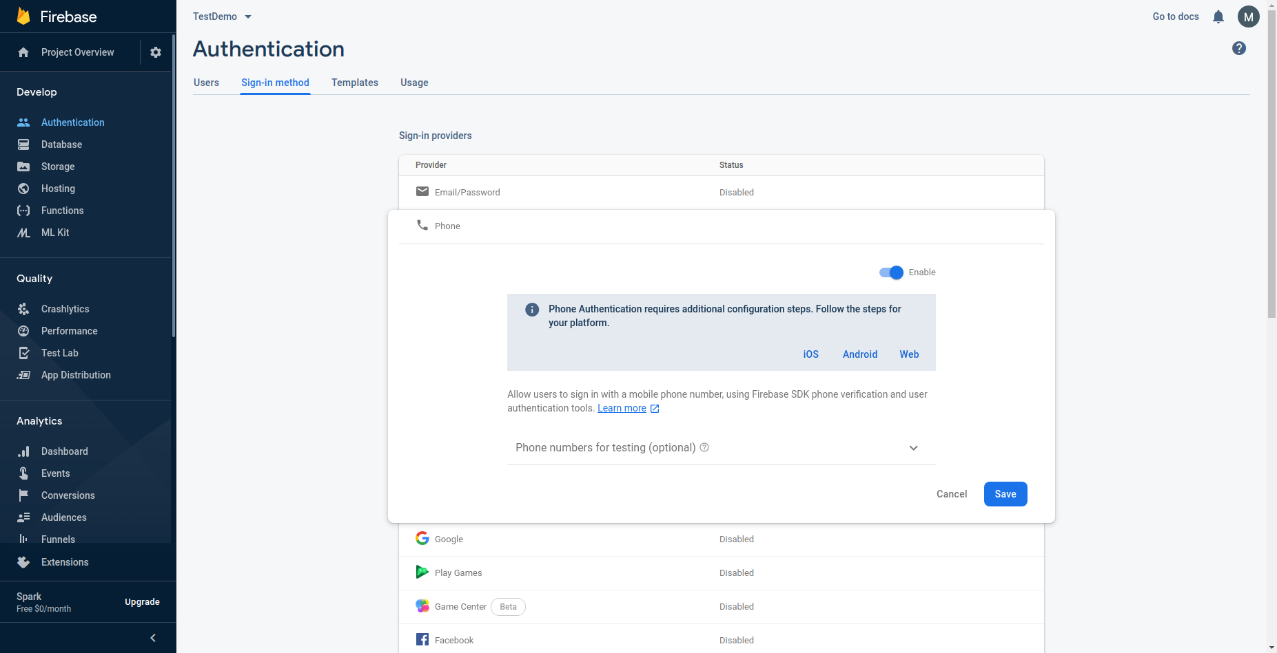

Slide 27

Google Assistant
App Actions help you expand the reach of your Android app by letting users launch directly into specific app features from Google Assistant. App Actions build on top of your app's deep links, giving users more ways to access the features they already want to use.
As an Android developer, you can implement one of the available built-in intents to help users get things done faster and more smoothly.

Slide 28

Expected Outcomes
This project is based on IOT(Internet of Things). IOT allows object to be sensed and controlled remotely across existing network infrastructure, creating opportunities for more accuracy and improving efficiency.
DeVoe’s Chair is a smart wheelchair which comes with a fall detection system, GPS tracking, sensing your body temperature, heart rate, intelligent picking along with a home automation system which can be controlled by google assistant or touch screen.
Through the app we can keep track of all the users logging in through the database.
Additionally the COVID-19 features news updates, statistics which helps in creating awareness throughout the nation as a necessity.

Slide 29
Future Scope
Obstacle sensors can be added detect hurdles in the path of wheelchair.
In fall detection we can use GSM module to send message on phone number also.
In future, we will try to add the robotic arm controlled by app for picking objects.
Voice controlled movement of chair using google assistant.

Slide 30
Individual Contribution
Modules | Contribution of each member
Module 1(Home automation System) | Khushi Rathore
Module 2(Fall Detection System) | Utkarsh Gupta
Module 3(GPS Tracking System) | Anjali Prajapati
Module 4(Heart Monitoring System) | Ayushi Jaimani and Sushant Sharma
Module 5(Movement of the chair through joystick) | Sushant Sharma
Module 6(Devoe's App) ~Structure ~Firebase Database, Authentication ~Google Assistant | ~Shikhar Srivastava ~Ayushi Jaimani ~Anutej Kardele

Slide 31
Reference
https://circuitdigest.com/microcontroller-projects/iot-based-patient-monitoring-system-using-esp8266-and-arduino
https://blog.asksensors.com/iot-cloud-based-gps-tracking-esp32-gps-neo-6m-module/#:~:text=Connect%20the%20GPS%20ground%20pin,computer%20through%20a%20USB%20cable.
https://www.eso.org/public/outreach/eduoff/seaspace/docs/navigation/navgps/navgps-1.html#:~:text=It%20has%20several%20components%2C%20each,geographical%20position%20of%20the%20user.
https://www.hackster.io/gatoninja236/esp32-fall-detector-b8ec6f
https://circuitdigest.com/microcontroller-projects/iot-based-patient-monitoring-system-using-esp8266-and-arduino
https://appuals.com/how-to-make-smart-home-automation-system-using-esp32-module/

Slide 32

THANK YOU

